Slide 1

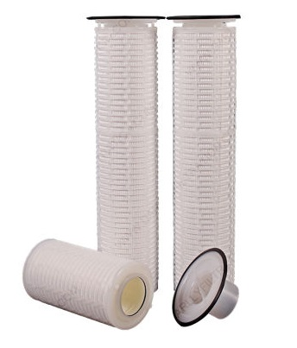
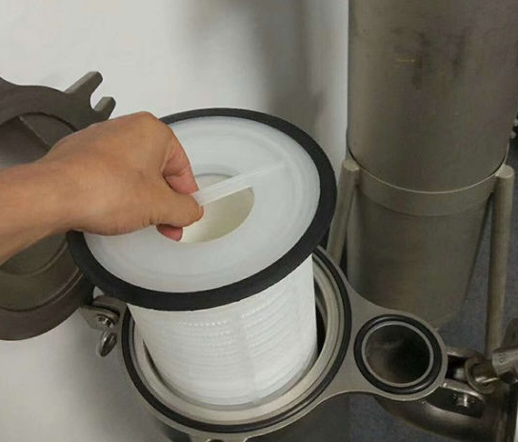
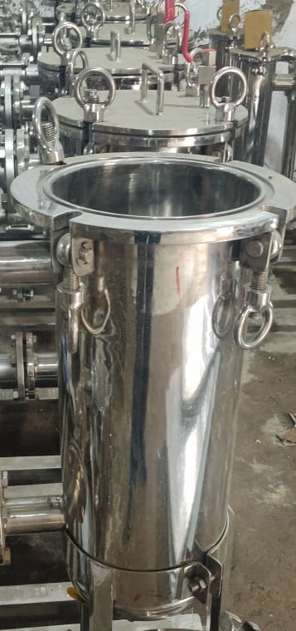
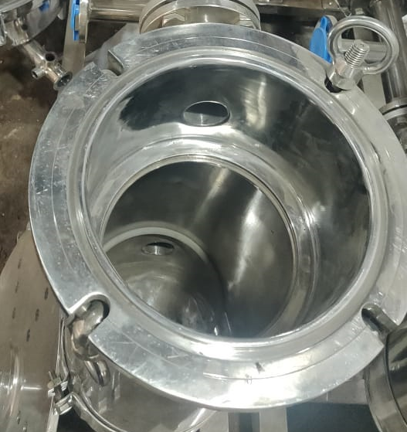
KGT SMITMANN FILTER
ABOUT
The KGT SMITMANN Cartridge filter has a controlled pore structure enabling removal of large range of particle sizes with consistent efficiency.
Apart from the wide chemical compatibility, the filters are suitable for either high flow rate or high viscous liquid, having a high dirt holding capacity.
The KGT SMITMANN cartridge filter is available in various removal ratings enabling it to handle a wide range of fluids.
ADVANTAGES
Due to wide range of media and pore size selection, a variety of liquids from acids to alkalis; from seawater to process water; and lube oils to petroleum fluid.
Standard dimensions of 7” outer diameter ensures fitment in most standard housings with varied length availability. (other dimensions available on request)
Available in 16 and 32 inches length. (Other lengths available on request.)
Sealing collars available in polypropylene.
DIFFERENCIAL PRESSURE DATA
For Normal Flow from Inside to Outside for liquids compatible with the filter media, the maximum differential pressure is
Polypropylene Medium: 15psid (1.0 bard)@75⁰C
Glass Fibre Medium: 15psid (1.0 bard)@120⁰C
(This dp data is compiled for Water Service)
APPLICATIONS
Process Water Lube Oils
Amine, Glycol Brine, Seawater
Top Entry
Fits in both vessel types
Side Entry

Slide 2
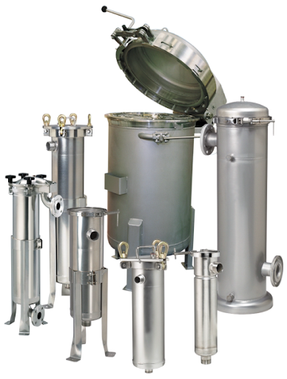
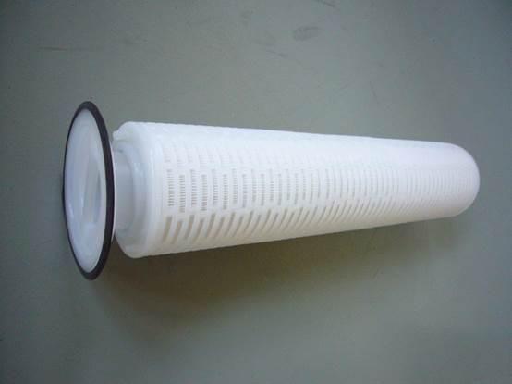
KGT SMITMANN FILTER
PART NUMBERING GUIDE
Filter Element Part Number : KGT - SM - - - - -
Collar Filter Media
Short Code Description Short Code Description
P Polypropylene P Polypropylene
GF Glass Fibre
Short Code Description
Diameter (inches)
7 7
Short Code Description
Length (inches)
16 16
32 32
Short Code Removal Rating (µm) Short Code Removal Rating (µm)
010 01 250 25
030 03 500 50*
050 05 1000 100*
100 10
 6, Anurag, Rajaji Path, Ramnagar, Dombivli, Mumbai, 421201, Maharashtra, India
 +91 251 2420878  +91 9166 593 315  solutions@klengas.com

